Slide 1
Talent to Value Showcase
July 2025

Slide 2













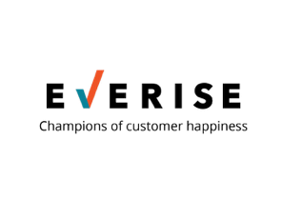








































































Our Clients
CONFIDENTIAL – NOT TO BE SHARED
ILLUSTRATIVE, NOT COMPREHENSIVE
PRIVATE EQUITY
PROFESSIONAL SERVICES
RETAIL/ONLINE RETAIL FORUM
HEALTHCARE/HEALTH TECHNOLOGY
FINANCIAL SERVICES
MEDICAL DEVICES
ENERGY & INDUSTRIAL
IT SERVICES
PHARMECEUTICALS AND LIFE SCIENCES
EDUCATION
OTHER
CONSUMER PACKAGED GOODS
INSURANCE

Slide 3

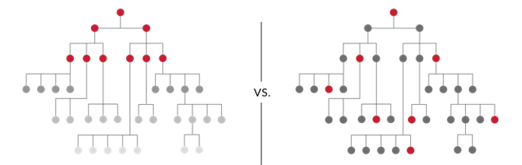



CEO-led Transformation
CONFIDENTIAL – NOT TO BE SHARED
Derailers
1
2
3
DOING TOO MUCH
PICKED THE WRONG PEOPLE
NOT ENOUGH TALENT
AT THE PROBLEM
Think BIG
Capital
Investments
=
Evidence Based
Risk Aware
Talent
Investments
=
Opinion Based
Risk Blind
VS.
Start BIG
Move s...l...o...w
“Prove me wrong”
“Fall in Love”
Hierarchy
Connected to Value
Starting more initiatives than there is capacity
Not aligning selection to value
Not factoring risks in role design and operating model
Focusing only on “top” roles
Not understanding and investing in (level-agnostic) roles critical to value creation

Slide 4
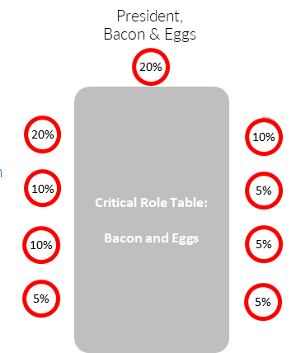

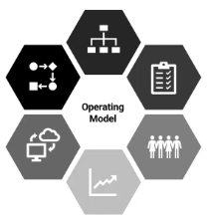


Talent to Value
CONFIDENTIAL – NOT TO BE SHARED
CEO lens to address derailers
Where is the
money?
How do I want
to run the place?
Is my leadership team ready?
Do we have
enough talent
at our critical roles?
Are we
mobilizing for success?
Value Agenda
Operating Model
Top Team Mobilization
Talent Capital
Balance Sheet
Mobilize the Value

Slide 5
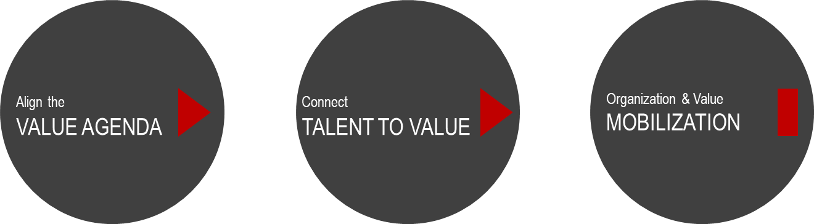
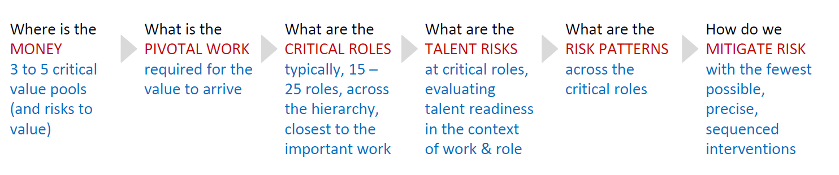
FulcrumQ Talent to Value IP
CONFIDENTIAL – NOT TO BE SHARED
FAST 2 to 6 weeks+ depending on scope & specific use case
LIGHT work with the CXO Team + 5 – 6 hotspot owners
MINIMALLY INVASIVE few, precisely targeted, sequenced interventions
FLEXIBLE & BESPOKE anchored in Talent to Value IP but solution mix specific to your context

Slide 6









Talent to Value
CONFIDENTIAL – NOT TO BE SHARED
Showcase
“Cut the Fat, Protect the Muscle”
Enabling the Business
A Missing Piece
Strengthening Foundations
Strengthen Op Model
Due Diligence
HR Strategy to Value
Build the Pipeline
Rapid Mobilization for Impact
CXO Enablement
Rapid Talent to Value @
BUs / Markets / Funcs
Succession Planning

Slide 7
Strengthen Operating Model

Slide 8
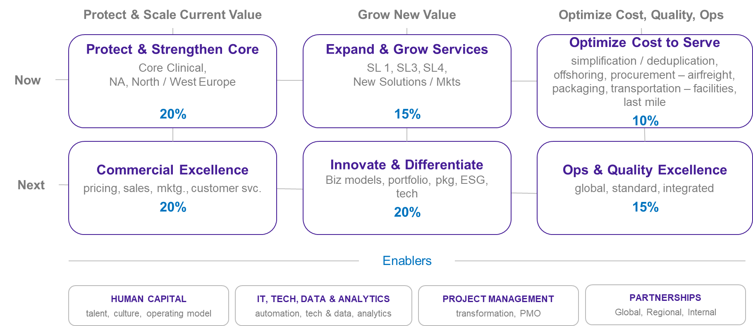
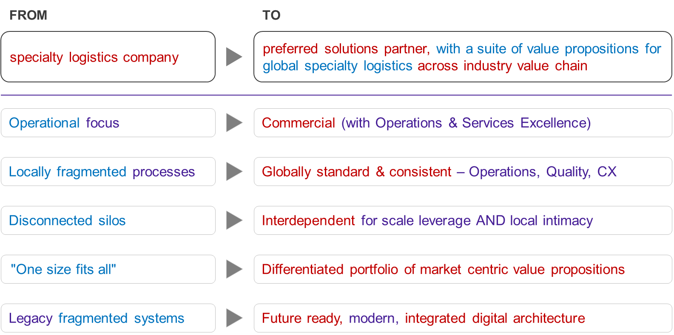
Strengthening the Op Model
CONFIDENTIAL – NOT TO BE SHARED
Where Is the Money?
What Needs to Change?
/VALUE
/WORK PIVOTS

Slide 9
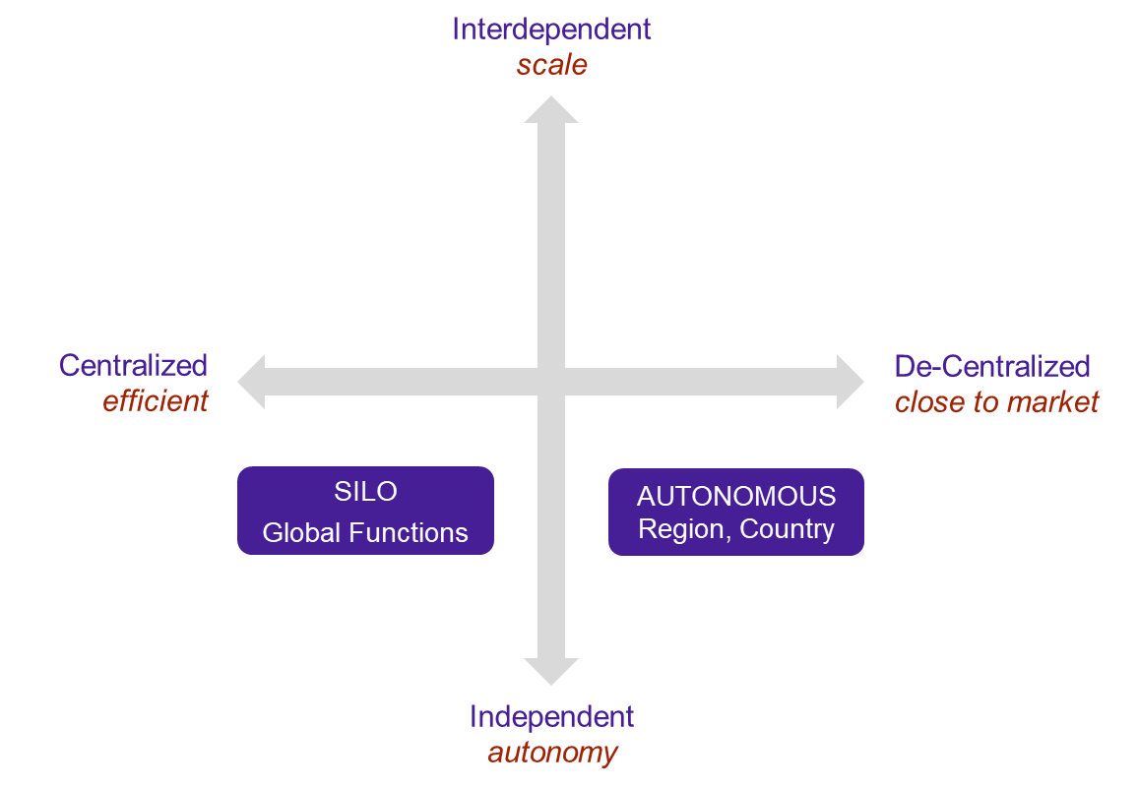
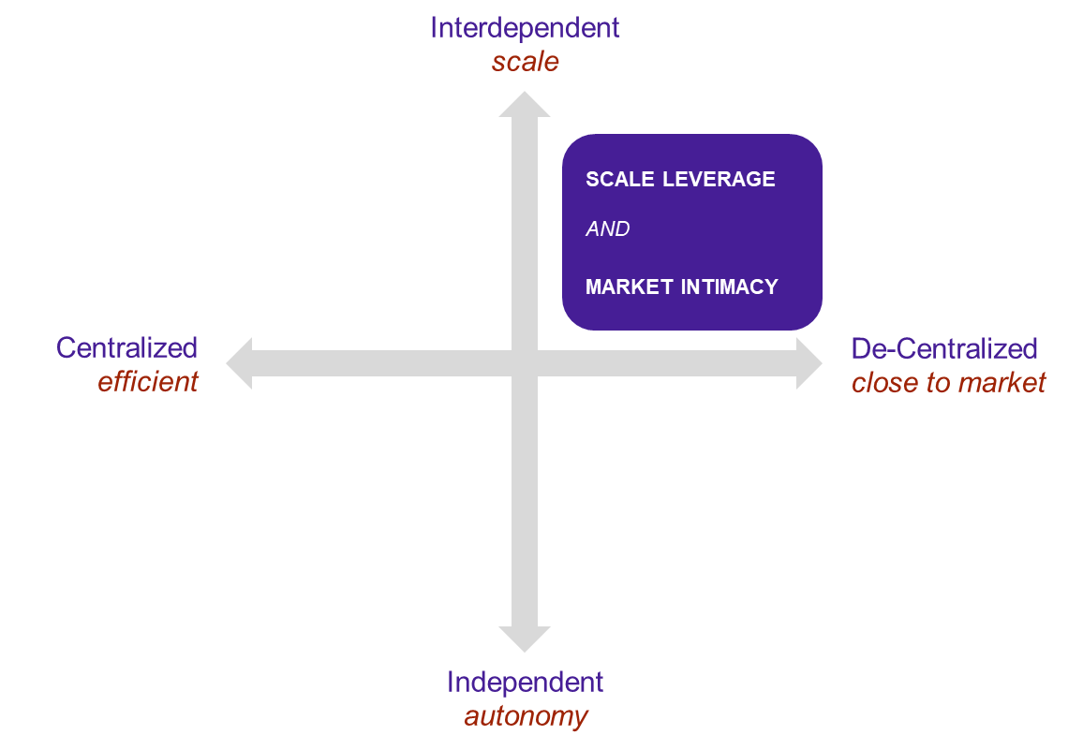
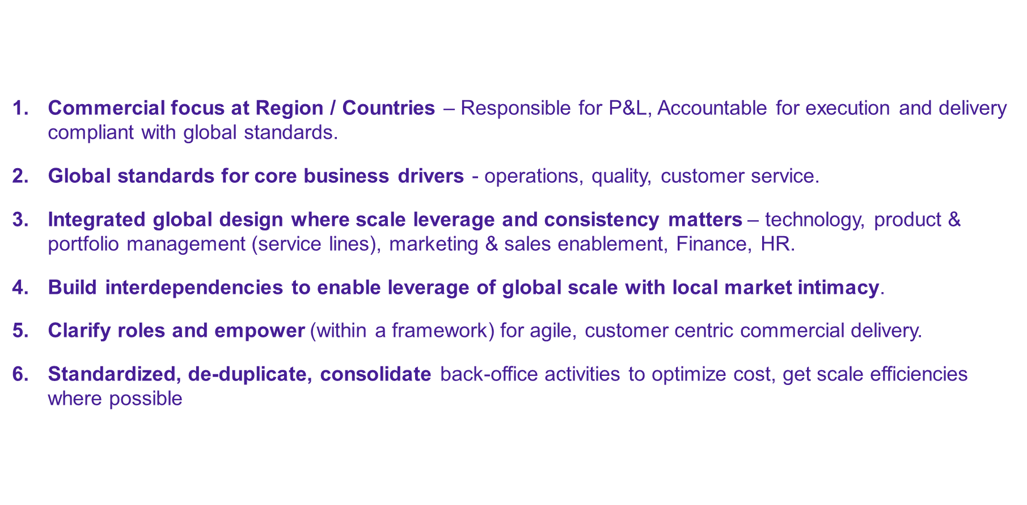
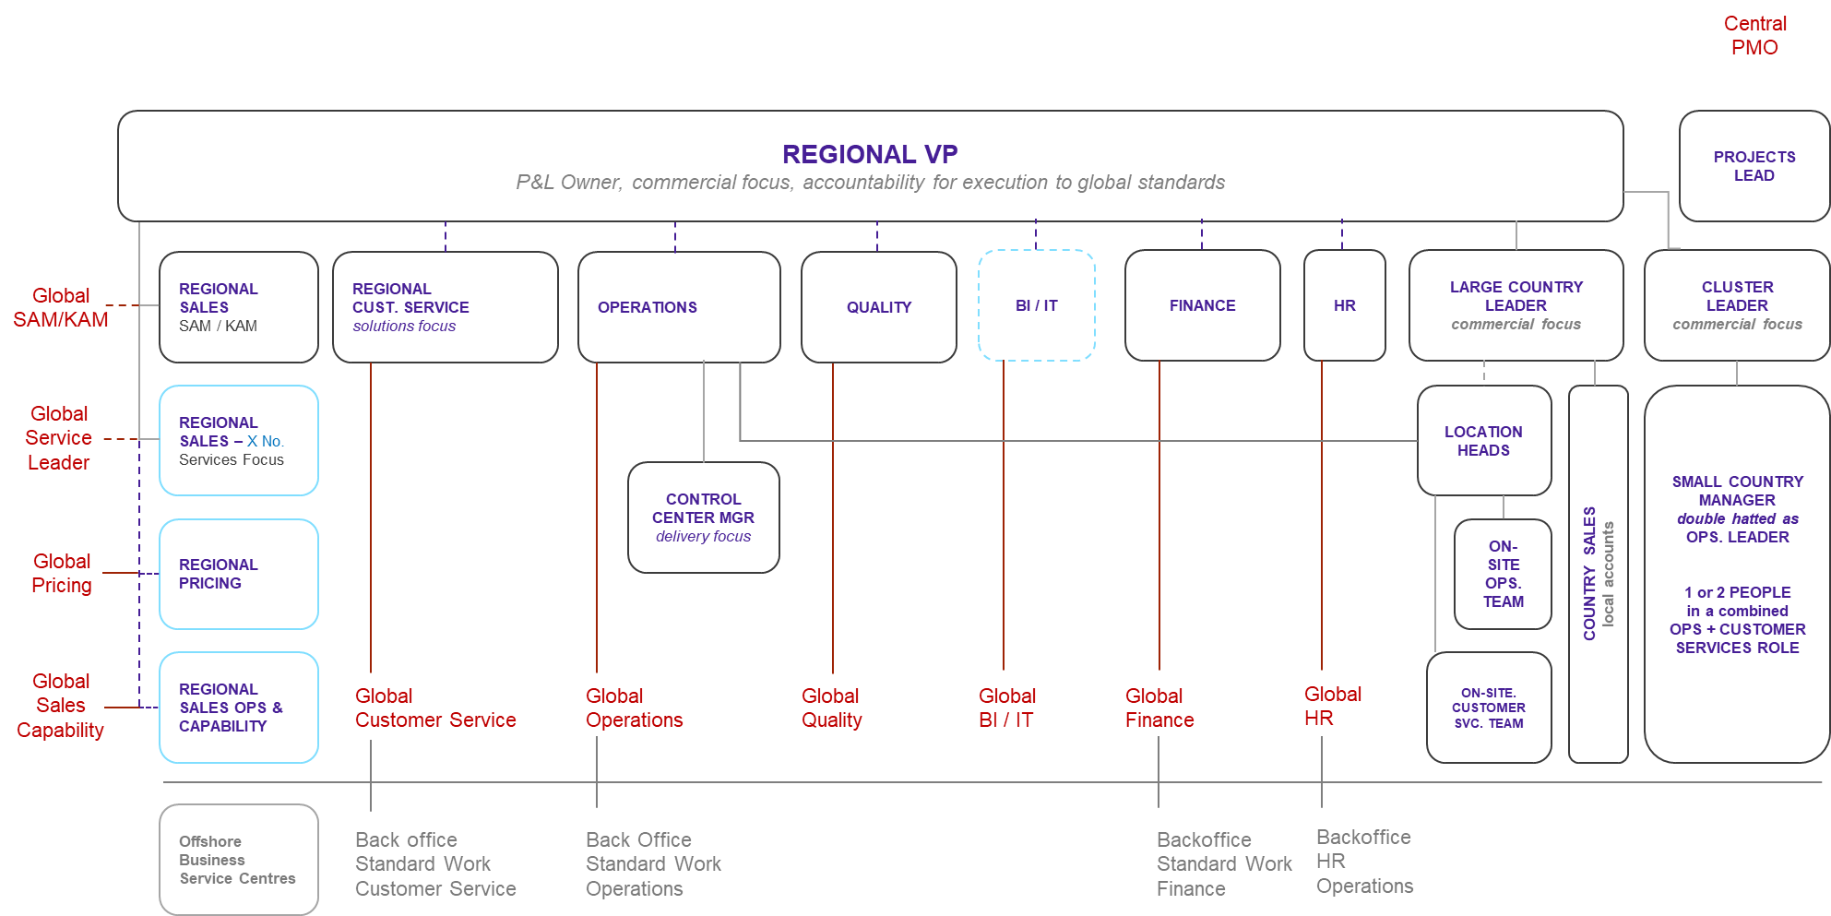
Strengthening the Op Model
CONFIDENTIAL – NOT TO BE SHARED
How Do We Run the Place
/OP MODEL PIVOTS
Design Principles
Op Model

Slide 10
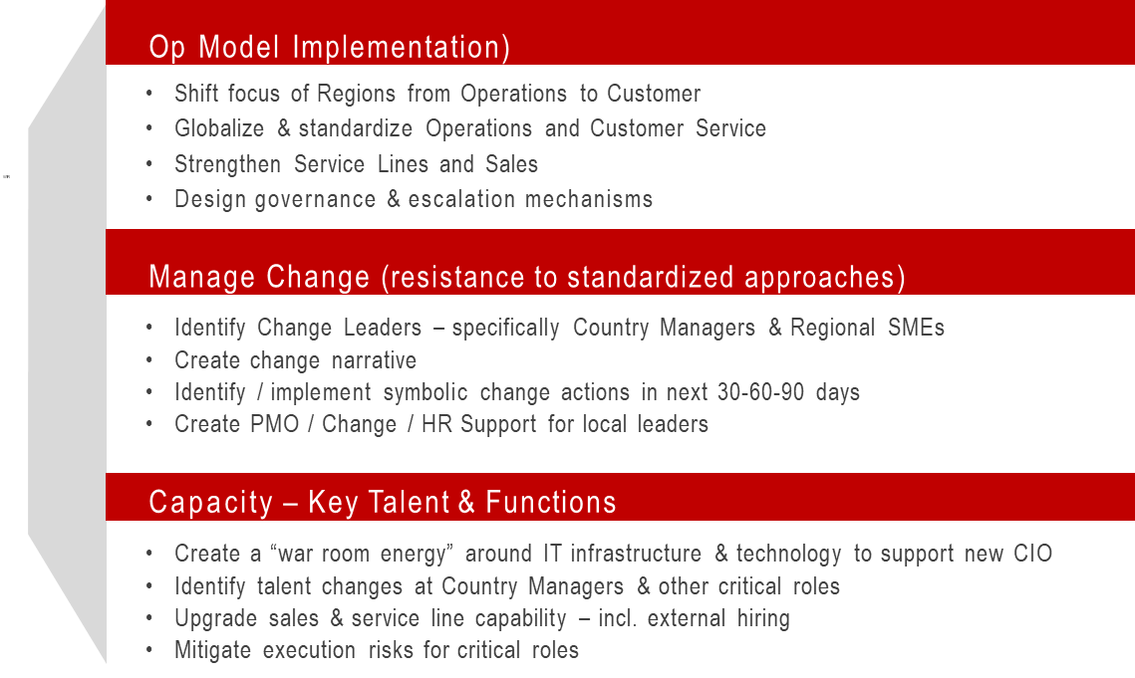
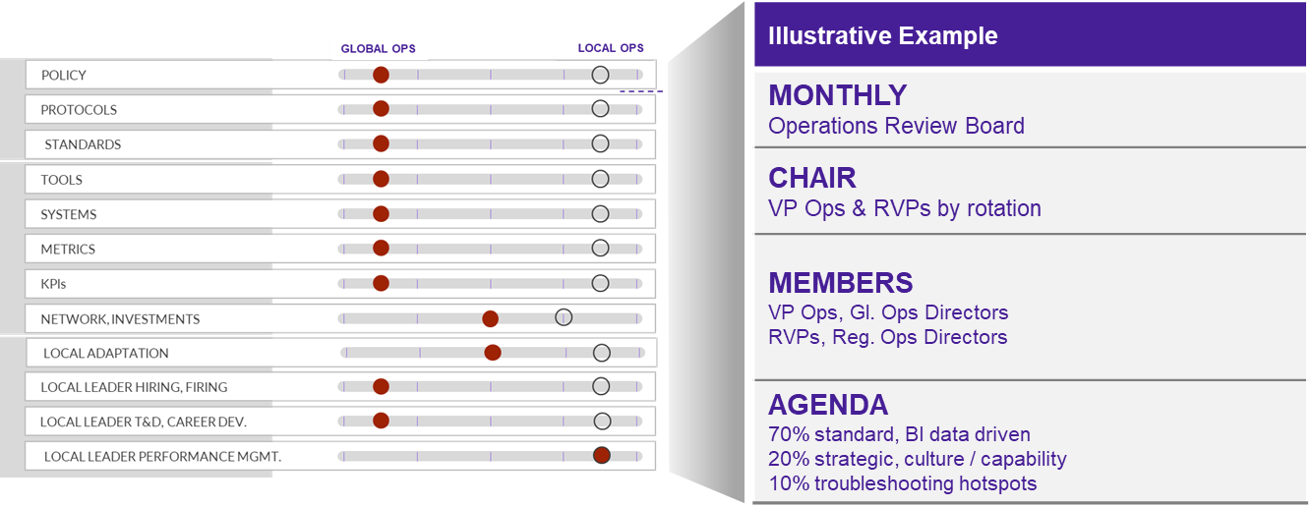
Strengthening the Op Model
CONFIDENTIAL – NOT TO BE SHARED
What Are the Critical Roles?
Shortest Path to Value?
/LIST
/MOBILIZE
Designing for Interdependence
Identify Critical Roles + Assess Risk
Strengthening Plan at interfaces / critical roles
Mobilizing Change

Slide 11
CXO Enablement

Slide 12



4 Pillars Essential for CXO Success
CONFIDENTIAL – NOT TO BE SHARED
CXO success
WHAT ARE THE BIG BETS TO DELIVER VALUE?
ARE THE STAKEHOLDERS ALIGNED TO THE BIG BETS?
“We Have a Brilliant CXO but do we have the Ecosystem for him to deliver?”
IS MY LEADERSHIP TEAM READY?
CEO, COO, CFO, CTO, CHRO, BU PRESIDENTS
ARE WE TALENTED ENOUGH AT THE POINTS OF VALUE?
EXCEPTIONAL TALENT IN 20 – 30 CRITICAL ROLES

Slide 13
Going green & global
CONFIDENTIAL – NOT TO BE SHARED
Regional centric business |  | More balanced local & international business & JVs
Commoditized, low growth, low margin portfolio |  | Differentiated, value-added product portfolio
Meeting construction needs at lower costs |  | Embracing sustainability and enabling green energy
(4x Volume, 5x Revenue, 6x EBITDA, 10x Net Income)
PHASE 1
STRONG START
ROLE FOCUS
PHASE 2
NEEDS TO EVOLVE
ROLE FOCUS
RUN
CHANGE
GROW
Driving performance over the last 17 years.
Executing reverse merger with help of Board
Strengthening financial foundations
New Operating Model
Leadership team upgrades
Culture of low accountability
Additional personal support to shape/drive the growth narrative
Make the operating model work
Strengthen Leadership bench strength
Define and detail an exciting growth narrative to Investors

Slide 14
CXO Value Ambition
CONFIDENTIAL – NOT TO BE SHARED
Deliver Strategy
Jobs to Be Done
Superpowers
Run core operations Grow organically & inorganically Drive decarbonized value- added products Build team for future ready organization.
JTBD 1
Protect Core While Enhancing Productivity
Strategic owner for delivering incremental revenue, through Asset Development, feedstock optimization, building materials, project implementation to protect market position & financials
Extract cost/productivity synergies from Digital Transformation programs (Smart Mfg., IOT, AI) to generate fuel for growth optimization
SP1:
Inspirational leader with ability to excite new investors & Board on growth agenda while sustaining operating results
SP2:
Decisive, mature leader to motivate leadership team and organization to deliver strategic pivots (think globally, JVs, M&A)
40%
JTBD 2
Diversify Decarbonize Product Portfolio For Organic Growth
Drive product portfolio for decarbonization
Drive Greenfield development JV
BU 2: Create comprehensive products, solutions, services portfolio for distributors, industrial clients, builders.
15%
JTBD 3
Build & Deliver Investment Case To Drive Inorganic Growth
Identify strategic targets for volume, revenue & EBITDA growth to secure Board approval and create interest from international institutional investors. Close deals / integrate acquisitions seamlessly for value creation
Identify and build JVs / commercial Partnerships
EXPECTED VALUE
15%
Click Score
BY 2028
5bn ADDITIONAL REVENUE
Expand Geographic Footprint
Enter new export markets for exports by capitalizing on demand for sustainable building materials
Explore opportunities to enhance vertical Integration
R
JTBD 4
W
56
15%
Organization & Operating Model
Select new leaders and (re)build leadership team for future ready organization, with high quality talent in critical roles
Strengthen new organization model and operating interfaces, clarify decision rights and align objectives & incentives
Define strategy deployment plan, align and mobilize leadership team and communicate to organization
Click Score
2bn EBIDTA
JTBD 4
15%
T
Medium forecast of value delivery

Slide 15
CXO Value Forecast
CONFIDENTIAL – NOT TO BE SHARED
Click Score
Work Score
WHAT’S THE PIVOTAL WORK?
Translate growth ambitions into organic and inorganic detailed execution plans + Build Board alignment
Build new organizational capabilities to deliver growth & decarbonization aspirations
Strengthen Operating Model and culture of accountability
W
R
Role Score
56
Click Score
Talent Score
T
IS THE ROLE/ORGANIZATION DESIGNED TO ENABLE VALUE DELIVERY?
The current mandate is challenging due to lack of detail and stakeholder alignment in the new growth initiatives.
Role design supports the mandate, but capability gaps in growth areas create a significant risk, both in the organization and leadership.
Operating model currently seems to prioritize functional needs over BU performance delivery, limiting effectiveness.
The Senior Leadership Team has some gaps (CEO BU 1). This requires him to step into operational details.
In addition, there are insufficient capabilities in critical areas: M&A, Corporate Finance, Investor Relations, Operations, S&OP, Procurement, Sales, and BU Financial Controllers.
Existing culture of "business as usual" is resistant to change which creates siloed behavior and low accountability across levels.
Need to improve external communication to effectively promote the growth story and attract investors.
JOBS TO BE DONE
40%
Protect & grow core while enhancing productivity
15%
Diversify & decarbonize product portfolio
15%
Build & deliver investment case to drive inorganic growth
15%
Expand geographic footprint
TALENT
15%
Organization & operating model
CXO has strong regional business experience with a solid operating track record. As a homegrown CEO and industry expert, he is well-regarded for his humility, empathy and ability to foster loyalty within the organization. Demonstrated learning agility in moving from operational to commercial roles, with support from strong mentor.
Has created an Operating Model that positions him for success as Holdco CEO but needs a bi-focal focus on driving core performance and building future growth. This requires him to delegate responsibility while maintaining accountability to ensure effective execution and ensure balance between short-term performance and long-term expansion.
Essential to have a more focused approach on fewer, prioritized strategic goals for greater impact. To do that, needs to enhance Board confidence by proactively detailing risk-aware investment & growth opportunities
Needs to complement his leadership team with global and M&A experience to effectively communicate an exciting growth narrative and secure investor buy-in for deals and decarbonized products.
May be perceived as "too nice," with a high affiliation style that can lead to avoidance of conflict and difficult conversations, particularly when needing to hold people to account for performance or making tough people decisions.
SUPERPOWERS
50%
Inspirational leader with ability to excite new investors & Board on growth agenda while sustaining operating results
50%
Decisive, mature leader to motivate leadership team and organization to deliver strategic pivots (think globally, JVs, M&A)
Risk Level:
70+
Low
56-70
Moderate
<55
High

Slide 16
CXO Value Forecast
CONFIDENTIAL – NOT TO BE SHARED
Click Score
CXO
Work Score
Alignment
Complexity
R
New Work
W
56
Competitive Intensity
Click Score
Role Score
Authority
T
Capacity
Work Score
Resistance
Incentives
Role Score
Talent Score
Talent Score
JTBD Match
Superpower Match
<50 – Lower forecast of value delivery
50-69 – Medium forecast of value delivery
70+ – Higher forecast of value delivery
Two-way fit
Track Record

Slide 17
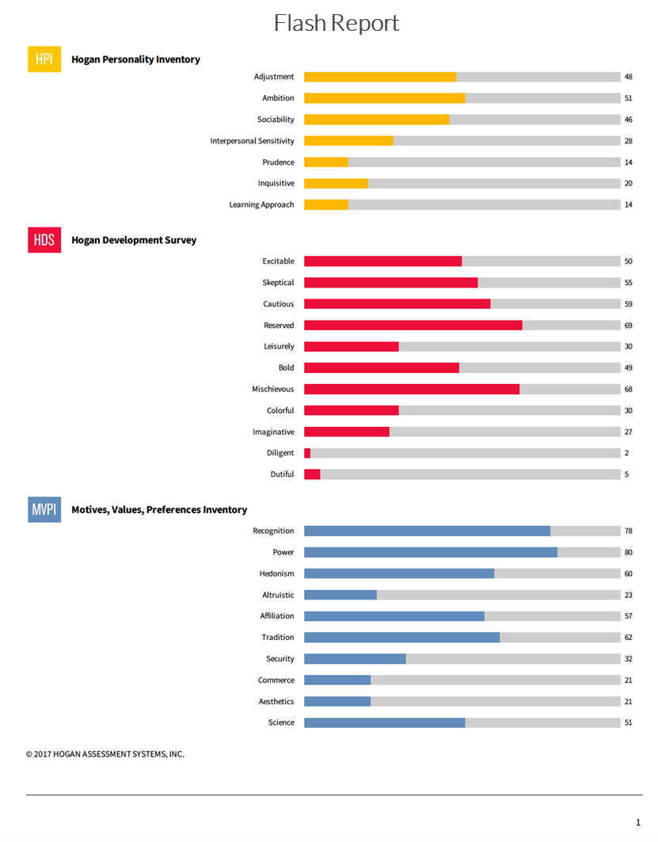
Hogan Assessment Summary
CONFIDENTIAL – NOT TO BE SHARED
Role · Talent Match
CXO has strong drivers related to creating impact and being seen and recognized as doing so. (High Power, High Recognition) . Additionally, his Ambition and drive points to his desire to lead and deliver results.
Potential Derailers
The profile suggests that this may not be a natural fit against transformative JTBDS related to expansion and diversification and that some complementing could help on these JTBDs. He tends to be pragmatic, a low-risk taker, focused on the tangible what is, rather than the unpredictability of what can be. (High Cautious, High Tradition, Pragmatic Learning Approach).
The profile also suggests that under stress, he can be seen as somewhat disconnected and uncommunicative which might impact the ability to engage and align the organization.
* Hogan insights should be read in conjunction with the detailed Hogan Report

Slide 18
The 4 Pillars Essential for CXO Success: Summary
CONFIDENTIAL – NOT TO BE SHARED
Clarity and Alignment on Mandate
1
Click between CXO Jobs + Ambition
2
Lack of clarity and insufficient alignment on mandate between stakeholders (Board, CEO, ExCo).
The vison has not been translated into specific and clear plans.
Low confidence among the Board and leadership team members regarding the achievability of these ambitions.
Strong regional and operational background capable of running the business.
However, his Jobs-to-be done readiness is ~50% (VA portfolio, inorganic growth, geographic expansion, operating model).
Relies heavily on Board’s guidance and lacks initiative for new growth opportunities.
Gap in defining and detailing an exciting growth narrative to build investor commitment & confidence to deliver deals.
Hesitant to make bold decisions and is corroborated with his Hogan.
Does not hold his team accountable for performance.
LT capability to deliver strategy
3
Organization capabilities & critical roles
4
CEO BU 1
CEO BU 2
CHRO
Chief Technology Officer
Projects Director
PMO & Transformation
Director
Chief Growth Officer
CFO
# | Role | Level
1 | Director BD and M&A | N-3
2 | Director Financial Planning & Control | N-4
3 | Director of Investor Relations | N-3
4 | Director Industrial Automation (IOT) | N-4
5 | Project Director | N-2
6 | Head of Integration (NEW) | N-3
7 | Head of Due Diligence (NEW) | N-3
8 | Head of Corp. Comms | N-2
9 | COO BU1 | N-2
10 | CCO BU1 | N-2
11 | VP Commercial BU 2 | N-2

Slide 19
CXO Enabling Success Plan
CONFIDENTIAL – NOT TO BE SHARED
What Are We Solving For?
Clarity on Mandate and Board Confidence in CXO to Deliver Mandate
Create CXO Capacity to Have Bifocal Focus on Balancing Core Performance & Growth
Making New Operating Model Work with an Effective & Aligned Leadership Team
Building New Capabilities
Strengthen Culture: Drive Culture of Accountability and Performance (internally) and Communicate the Growth Story to Attract Investors (externally).
WHAT IS THE ENABLING CEO SUCCESS PLAN?
POTENTIAL FOR
CLICK SCORE IMPROVEMENT
1. Clarity on MANDATE and board confidence in CXO to deliver mandate
Precise Jobs To Be Done for CXO for the next 12 months. Make sharp choices, and co-create between CXO & Board
Strengthen relationships with Board members
Explore Advisors with specific inorganic growth experience (M&A, global)
2. Create CXO Capacity to have BIFOCAL focus on Balancing core performance & growth
Release Personal Capacity from “Running” BU1. Upgrade BU1 leadership.
Prioritize the number of strategic initiatives
Leverage the CFO and the CEO BU2 as a sounding board within the ELT
Clarify role and remit of the Advisor (Government Affairs to drive organic growth & Board relationships)
3. Make Operating Model work
Quick Wins (BU Finance support)
Define role of Corporate Centre to drive Enterprise priorities and what can be pushed down to BU CEO remit (incl. functions).
Drive x-function collaboration
4. Build new capabilities
Prioritize and Build capabilities in M&A, Corporate Finance, Inv. Relations, Operations, S&OP, Procurement, Sales, BU Financial Controllers, HR
Identify critical roles, assess risks and build risk mitigation plans (incl. succession planning)
Prioritize and Proactively Build Bench @ BUs (over next 12 months).
Assess, address and strengthen N-2 capacity in BU1 Leadership team
Strengthen Culture
Reinforce desired mindset of accountability and performance. Hold BU LTs accountable for performance
W
R
56
Click Score
T
W
R
70
Click Score
T
Note: Success Plan actions are listed in order of relative importance

Slide 20
PE / Due Diligence

Slide 21
Talent to Value across the Deal Lifecycle
CONFIDENTIAL – NOT TO BE SHARED
1
PRE-DEAL DILIGENCE what are leadership, transition risks?
2
DEAL CLOSE do we have the right leader and a winning leadership team?
3
HOLD PERIOD
how can we accelerate time to value? reduce volatility of returns?
4
EXIT VENDOR DUE DILIGENCE how can we improve our value realization?

Slide 22
Pre-Deal Diligence
CONFIDENTIAL – NOT TO BE SHARED
Talent2Value Approach
Kickoff
Week 1
Week 2
Week 3
Week 4
Management/Banker Presentation Management Financial Model Draft Thesis VDD/Interim DD in Data Room | Listen into Management sessions (with DD Partners) 90 min discussion with Deal Team + Ops Team | Attend Management Presentation Pre-meeting comfort building with seller, brief to Management Leader meetings in person or virtual (1 to 2-hour 1:1s) | Collate evidence data from outside- in references DD sessions with Mgmt and 1:1 conversations with leaders
Understand the business Intake & document/data review Q&A with Deal + Ops team | Align on hypothesis on value, key pivots for value to arrive Roles proximate to work | Relaxed discussion on work, risks, team, org (NOT an assessment) Updating hypothesis based on discussions | Synthesize and build the evidence mosaic for the key diligence questions, and Leadership Talent
‘Strawman’ Value Agenda & List of Critical Roles | Value Hotspots, Critical Roles Brief partners for outside-in low touch talent data | Evidence on value, work pivots, risks, talent in the team Human data – identity, beliefs, motivations | 2 Page Executive Summary for IC Detailed readout for the deal team
Inputs
Work
Output

Slide 23
Pre-Deal Diligence Case Study
CONFIDENTIAL – NOT TO BE SHARED
Four Week Sprint – Leadership Talent Dd Adjacent to Finance, Legal, Operational DD
Diligence Key Questions
Deal Context
LEADERSHIP TALENT : How strong are the CEO & Leadership Team?
LEADERSHIP TEAM RISKS
Motivations of the CEO and Leadership Team to stay on
Capacity, Capability and Fit for CEO and Leadership Team for the thesis
BENCH-STRENGTH
Succession planning & bench-strength for CEO’s direct reports
Indicative Critical Roles and view on bench-strength deeper in the Org.
MANAGEMENT GAPS vs THESIS: Gaps in Management, Org. Capability/Structure vs. Pivots required to deliver the thesis.
DATA INSIGHTS: Key insights from Employee / Engagement Survey and Attrition Data as made available by the target.
Financial sponsor evaluating buyout of privately held Global Consumer Services Business.
Leadership Team comprising of CEO, 8 Direct Reports and 2 Obviously Critical Roles not formally a part of the Executive Leadership Team.
Team executed a tough turnaround under current shareholder. Future thesis hinges on pivoting to growth.
Large core business with leading positions in the Companies categories in key markets, with limited growth potential.
Significant attractive organic and inorganic growth optionality but limited in-market evidence.

Slide 24


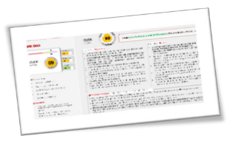



Pre-deal Diligence Output: Readout Summary
CONFIDENTIAL – NOT TO BE SHARED
Pragmatic, Actionable Input, Enabling Sponsor to Underwrite Talent Risks Better
2 Page Executive Summary for IC
TYPICAL OUTPUTS | ILLUSTRATIVE HEADLINES
Top Team Assessment CEO Leadership Talent & Leadership as a team Risks in transition Bench strength for leadership | CEO not recommended for thesis: blind spots in thinking strategically for a sustainable org, capabilities; Bias to short term thinking Winning turnaround team that is driven top down, complements with CEO, and works well with each other Ready and keen internal successor available for CEO in transition. 3 Roles (and 1 advisory role) critical for continuity in transition; medium risk of attrition. Balance talent fungible. Leadership succession weak, work in progress.
List: 41 Critical Roles Talent beyond CEO & Direct Reports Bench strength at Critical Roles | List of Critical Roles across hierarchy and functions (going down to N-3) View on role talent match at Critical Roles (per company view), and brief commentary on risks
Organizational Beliefs and Capability Risks Areas of high & low belief in the thesis Function / Capability strengths and gaps | Belief in ___ parts of the thesis inconsistent; internal misalignment around path forward on ___ key initiative Organization gaps translate into adjusted in EBIDTA, with estimates of costs to elevate to required capability (8-10 net new roles, adjust EBIT by $x Mn)
Engagement & Culture Analysis Data driven insights on attrition Engagement Surveys | High goal clarity, low loyalty, high burnout, disengagement Hotspots in engagement, attrition in … key levers to deploy
Top 5 Watchouts & Recommendations Post transaction value creating moves | Stabilize and consolidate structure/processes, Rebalance resourcing in ABC areas, Management construct for transition – 3 Scenarios
Detailed readout for the Deal Team

Slide 25
Rapid TALENT2VALUE @ BU / Market / Func

Slide 26
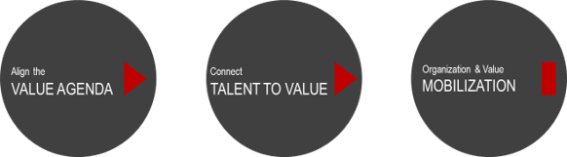
Rapid TALENT2VALUE
CONFIDENTIAL – NOT TO BE SHARED
CONNECTING TALENT TO VALUE
Diagnostics
Working Session(s)
Wrap-up
Document Review (Strategy, Business Plan, results) + 2-3 Intake interviews (CEO, CFO, CHRO, Strategy) on
Where is the Money
What are the Strategic Pivots
What are the 3-5 critical bets to drive value (or risks to value)
Choices (if any) on operating model & organization
Working Session 1 to align on pivots, value hotspots, work headlines
Working Session 2 to identify , critical roles across the hierarchy & risks ((Talent Capital Balance Sheet)
Working Session 3 to identify risk patterns and high-level interventions (org level and for critical roles)
Read-out with CEO/CHRO on Mobilization actions across pillars essential for CEO success

Slide 27
Strategic Pivots → Value Hotspots → Work Headlines
Food security mandate |  | Integrated food distribution company
Management of contract farming |  | Innovation driver in Agri-tech
Grants dependent & sub-scale entities |  | Commercially sustainable, profitable & independent company
STRATEGIC PIVOTS
FOODSERVICE
30%
F&V
20%
FARMING & FOOD
20%
INORGANIC EXPANSION
10%
DIGITAL
5%
VALUE HOTSPOTS
Complete Integration of new acquisition X into HoldCo
Leverage new capabilities to accelerate organic growth by increasing customer base & value-added services in Country 1 & 2
Expand offering to win ‘center of plate’ beyond core F&V portfolio – proteins, key staples and value add products / solutions
Unlock subsidiary synergies to grow pest controls and services
Grow commodity distribution
Integrate F&V Retail and Wholesale channels with AA
Extract synergies, restructure F&V BU, right-sizing commercial and operations
Leverage capabilities to accelerate organic growth by growing and expanding into new product categories across in key markets in Country 1, Country 2, Region A
Build R&D capabilities to enhance farmer eco-system, & provide local farmer support (improving yield, novel crops)
Optimize management of strategic food reserves through food security intelligence
Strengthen crisis management capabilities
Manage risk, continue rotation of commodities (esp. sugar)
Expand product categories with a focus on integrated red meat, seafood, rice, and pulses
Integrate upstream and downstream value chains, including production, manufacturing, processing, packaging, and market routes (e.g., B2B wholesale)
Form joint ventures, strategic partnerships, and pursue opportunistic M&A to grow business in select markets
Develop a Digital Strategy & roadmap to drive innovation in agriculture and food value chains
WORK HEADLINES
ENABLERS 15%
FINANCIAL ACUMEN
& RISK MANAGEMENT
STRATEGY
ESG
IT FOUNDATIONS
HUMAN CAPITAL & CULTURE

Slide 28
Critical Roles and Risks @ Value Hotspots
CONFIDENTIAL – NOT TO BE SHARED
Foodservice
30%
F&V
20%
Farming & Food
20%
Inorganic Expansion
10%
Digital
5%
Enablers
15%
$990M
$660M
$660M
$330M
$165M
$495M
CRITICAL ROLES @ EACH HOTSPOT
CRITICAL ROLE | VALUE (%) | ROLE VALUE (USD)
Chief Commercial Officer X | 20% | 198
Chief Operations Officer X | 20% | 198
Head - Market Intelligence | 10% | 99
Category Head 1 | 7% | 69
Category Head 2 | 7% | 69
Category Head 3 | 7% | 69
Head of Export X | 5% | 50
Head of Local X | 5% | 50
Strategy Lead X | 5% | 50
Head of Integration | 5% | 50
MD (acquired entity) | 5% | 50
MD Y | 4% | 40
CRITICAL ROLE | VALUE (%) | ROLE VALUE (USD)
Chief Operating officer AA | 40% | 264
CEO AA | 20% | 132
Chief Commercial Officer AA | 15% | 99
Head of Integration | 10% | 66
MD (acquired entity) | 10% | 66
Head - Market Intelligence | 5% | 33
CRITICAL ROLE | VALUE (%) | ROLE VALUE (USD)
Head of AgTech | 30% | 198
Chief Farming Officer | 25% | 165
Head of Strategic Reserves | 20% | 132
Head of Innovation (Distr/Food Svcs) | 15% | 99
Business Development Head (R&D) | 10% | 66
CRITICAL ROLE | VALUE (%) | ROLE VALUE (USD)
Director of M&A | 40% | 132
Head of Integration | 25% | 83
CEO AA | 15% | 50
Head of Local – X | 10% | 33
Head of Strategy | 10% | 33
CRITICAL ROLE | VALUE (%) | ROLE VALUE (USD)
CRITICAL ROLE | VALUE (%) | ROLE VALUE (USD)
Head of FP&A | 20% | 99
Director IT (Digital Foundations) | 15% | 74
VP Treasury | 15% | 74
Head of Finance (cost control) | 10% | 50
Head of Governance (Finance) | 10% | 50
Director ESG | 10% | 50
Head of Talent Acquisition | 10% | 50
Head of Workforce Planning & OD | 5% | 25
Head of Strategy | 5% | 25
Emerging Hotspot Risks
FOODSERVICE: Top 2 roles assessed as “Red” and 5 new roles. Significant value creation will come from identified X roles (~35-40%) which have not been assessed.
F&V: Top 2 roles require assessment, and the remaining roles are new
FARMING & FOOD: Top 2 roles are “amber” and the third role needs to be broadened. The remaining roles are new
INORGANIC GROWTH: Top role is “amber” and the second role is new and may be under-resourced
New Role

Slide 29
Value Ranked List of Critical Roles
CONFIDENTIAL – NOT TO BE SHARED
9 New Roles Will Generate 25% of Future Value
TOP 15 ROLES DRIVE 73% OF THE VALUE
BOTTOM 15 CRITICAL ROLES DRIVE 27% VALUE
Rank | Value Ranked Critical Roles | Value (USD M) | Cumulative %
1 | Chief Operating officer AA | 264 | 8%
2 | Head of AgTech | 198 | 15%
3 | Chief Commercial Officer X | 198 | 21%
4 | Head of Integration | 198 | 27%
5 | Chief Operations Officer X | 198 | 34%
6 | CEO AA | 182 | 39%
7 | Chief Farming Officer | 165 | 45%
8 | Director of M&A | 132 | 49%
9 | Head - Market Intelligence | 132 | 53%
10 | Head of Strategic Reserves | 132 | 57%
11 | MD (acquired entity) | 116 | 61%
12 | Chief Commercial Officer AA | 99 | 64%
13 | Head of Innovation (Distr/Food Svcs) | 99 | 67%
14 | Head of FP&A | 99 | 71%
15 | Head of Local X | 83 | 73%
Rank | Value Ranked Critical Roles | Value (USD M) | Cumulative %
16 | VP Treasury | 74 | 76%
17 | Director IT (Digital Foundations) | 74 | 78%
18 | Category Head 1 | 69 | 80%
19 | Category Head 2 | 69 | 82%
20 | Category Head 3 | 69 | 85%
21 | Business Development Head (R&D) | 66 | 87%
22 | Head of Strategy | 58 | 88%
23 | Strategy Lead X | 50 | 90%
24 | Head of Export X | 50 | 92%
25 | Head of Governance (Finance) | 50 | 93%
26 | Director ESG | 50 | 95%
27 | Head of Finance (cost control) | 50 | 96%
28 | Head of Talent Acquisition | 50 | 98%
29 | MD Y | 40 | 99%
30 | Head of Workforce Planning & OD | 25 | 100%
30% (9/30) roles in X & AA. Will need to determine location of roles, and assess need to merge / eliminate / create new roles post integration
Digital & R&D requires further detailing
Head of Integration timing TBD

Slide 30
Human Capital Balance Sheet
CONFIDENTIAL – NOT TO BE SHARED
Human Capital Insights
All N-1 Roles Remain Accountable for Value Creation, Though Not Explicitly Labeled Critical. the CHRO and CFO Roles Were Discussed, but the Critical Roles Identified Were at the N-2 Level Based on Required Work
Majority of Roles Appear to Be Set up for Success (authority, Team Capability)
Need to Assess and Address Talent Risks (starting with COO Aa, CCO X, COO X, CEO Aa)
Due to Recent Acquisitions, Details on Key Roles in X & Aa Are Limited. Synergies and Talent May Exist, Especially in Commercial and Operations
Within HoldCo, Further Effort Required to Define the Work & Roles in Digital and R&D/Innovation
Ability to Scale Assessment Requires Further Detailing
Succession Plan for Critical Roles Appears Limited
The Timing for Filling New Roles Needs Review Potentially Starting with Three Key Positions:
Head of Integration – Given Criticality of Integration to Extract Synergies and Drive Organic Growth, Handling This under the Strategy Officer May Not Be Optimal
Broadening Strategic Reserves Role to Include (proactive) Food Security Intelligence & Crisis Management Seems Critical to Meet Stakeholder Needs
Head of Market Intelligence Seems Critical to Forecast Trends, Identify Growth Opportunities Using R&D & Drive Stronger Partnerships with Acquired Entities & Geographies
Human Capital Balance sheet represents the business view of overall talent risk (red-amber-green)
Legend
= No Significant Execution Risk
= Some Execution Risk, Intervention Suggested
New Role
= Significant Execution Risk, Intervention Required

Slide 31
HR Strategy to Value

Slide 32
Talent to Value HR strategy
CONFIDENTIAL – NOT TO BE SHARED
Connected to Business Value & Jobs to Be Done
TALENT TO VALUE
HR STRATEGY TO VALUE
Data driven; evidence based Human Capital Insights

Slide 33
HR Strategy Connected to Business Value
CONFIDENTIAL – NOT TO BE SHARED
Business
Jobs to Be Done
Strategic
Human Capital Considerations
Protect and strengthen core business, in core citadels of North America, West Europe, North Europe Expand services, whitespaces – High growth high margin service lines Pivot from operational focus to commercial excellence strengthen capabilities in sales, pricing and customer (engagement, service, experience) Innovate and differentiate to build a portfolio of fit for purpose, strong value propositions for a portfolio of service offerings. Deliver globally integrated, tech enabled, scalable operations and quality excellence. Optimize cost to serve – simplification, strategic outsourcing and Procurement
CEO – Commercial, driven but new, impatient, under pressure and driving a lot of change in an org and LT where maturity could be low.
Leadership Team – Relatively new with 10/12 < 1 year tenure, 1 new addition and 3 changes planned. Managing top team dynamics is important.
Country managers – long tenured, comfortable, likely source of most resistance to transformation.
Capacity at N-1 & capability to manage change to drive the pivot from independent to interdependent
Significant simplification / strategic outsourcing opportunity – sequence? owner?

Slide 34
HR Strategy Data Driven Human Capital Insights
CONFIDENTIAL – NOT TO BE SHARED
CULTURE
consistent themes on trust in leadership, managing change, morale / optimism for the future TALENT ACQUISITION largely internal pool, slow for senior roles (> 90 days), local for high volume roles, inconsistent and local in FR, NL, TR TALENT RETENTION higher in BU1 (35%) vs. other BUs, with hotspots in NL, Turkey and Norway. Turkey has high churn (42% < 2 years). High frontline churn (25%) TALENT SUCCESSION & DEVELOPMENT
Internally focused and biased to finance. Limited to no visibility outside BU and seemingly absent approach to talent mobility. Weak ready now bench. Inconsistent approach to talent development across regions
PERFORMANCE & REWARD
Performance differentiation is low (likely linked to goal setting). Compensation and reward not consistent or harmonized across BUs, regions or even within countries. Comp levelling likely biased to tenure than potential or performance.
ORGANIZATION Legacy of local, organic evolution as opposed to strategic design. Overlayered and inconsistent in levels, layers and spans across regions / countries. Significant de-duplication, shared services opportunity.
CULTURE & ENGAGEMENT
TALENT ACQUISITION
TALENT RETENTION
TALENT DEVELOPMENT
PERFORMANCE & REWARD
ORGANIZATION

Slide 35
HR Strategy Bringing IT Together
CONFIDENTIAL – NOT TO BE SHARED
Business JTBDs
HR Functional Insights
HR JOBS TO BE DONE
Enabling the Business
Enterprise HR Enablers
Foundational HR Excellence

Slide 36
HR Strategy HR Jobs to Be Done
CONFIDENTIAL – NOT TO BE SHARED
ENABLING THE BUSINESS (STRATEGIC BUSINESS PARTNER)
Drive the Strategic operating model pivot enabling a commercially focused, operationally consistent, future ready, interdependent business .
Build capacity and capability (talent, skills, knowledge) at (N-2) to deliver commercial excellence, innovation and operational excellence, quality and customer service.
Build change management capability to enable the operating model pivot with a “bias for action” and to a Enterprise mindset
Optimize costs through organizational simplification, de-duplication and execution of Shared Services / offshoring strategy.
ENTERPRISE HR ENABLERS
Own HR Strategy Development for talent mobility, compensation, goal setting and performance management – working seamlessly with global functions AND optimized for specific BU context. Support operating business HR leaders to translate to their businesses.
Business Leadership and Critical Roles selection, succession, bench and team effectiveness for each operating business.
Strengthen HR leadership at Critical Roles, define and implement appropriate functional operating model and build capabilities required to build robust functional foundations AND pivot the function from transactional basics to a strategic business partner
Build and execute the HR shared services model
Develop and execute the program for Offshoring Strategy and Organizational Optimization (simplification, de-duplication, consistency) across BUs
FOUNDATIONAL HR EXCELLENCE
World class people analytics to support data driven insights to inform and shape business decisions
Strengthen HR foundations with a focus on talent excellence – selection, succession / bench strength, training and development, goal setting and performance management

Slide 37
HR Strategy Getting Started
CONFIDENTIAL – NOT TO BE SHARED
ENABLING THE BUSINESS (STRATEGIC BUSINESS PARTNER)
Design & implement operating model shifts – organization design, change narrative, PMO, change leaders
Design & deploy a regular program to drive high performance in the top team with a focus on onboarding / replacing new LT members
Talent acquisition in Service Lines & Sales
Simplify organization & reduce costs
Customer Services roles at lower job levels in 4 high-cost countries (US, UK, Switzerland, Germany)
US structure with a focus on large, senior-heavy sales force at mid-level job levels
People leaders at lower job levels with 1-3 direct reports in 4 High-cost Countries (Canada, UK, Spain, Switzerland)
ENTERPRISE HR SUPPORT
Build CoE alignment for Enterprise HR Strategy with a focus on talent mobility, compensation, goal setting and performance management
Identify critical roles across the BUs
Assess succession readiness at LT-1 and critical roles across BUs Business Leadership and Critical Roles selection, succession, bench and team effectiveness for each operating business.
Determine Enterprise approach for strategic offshoring across BUs
FOUNDATIONAL HR EXCELLENCE
Build people analytics capabilities to support data driven insights to inform and shape business decisions
Build and execute the HR shared services model
Identify and strengthen HR critical roles

Slide 38
Succession Planning

Slide 39
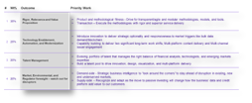
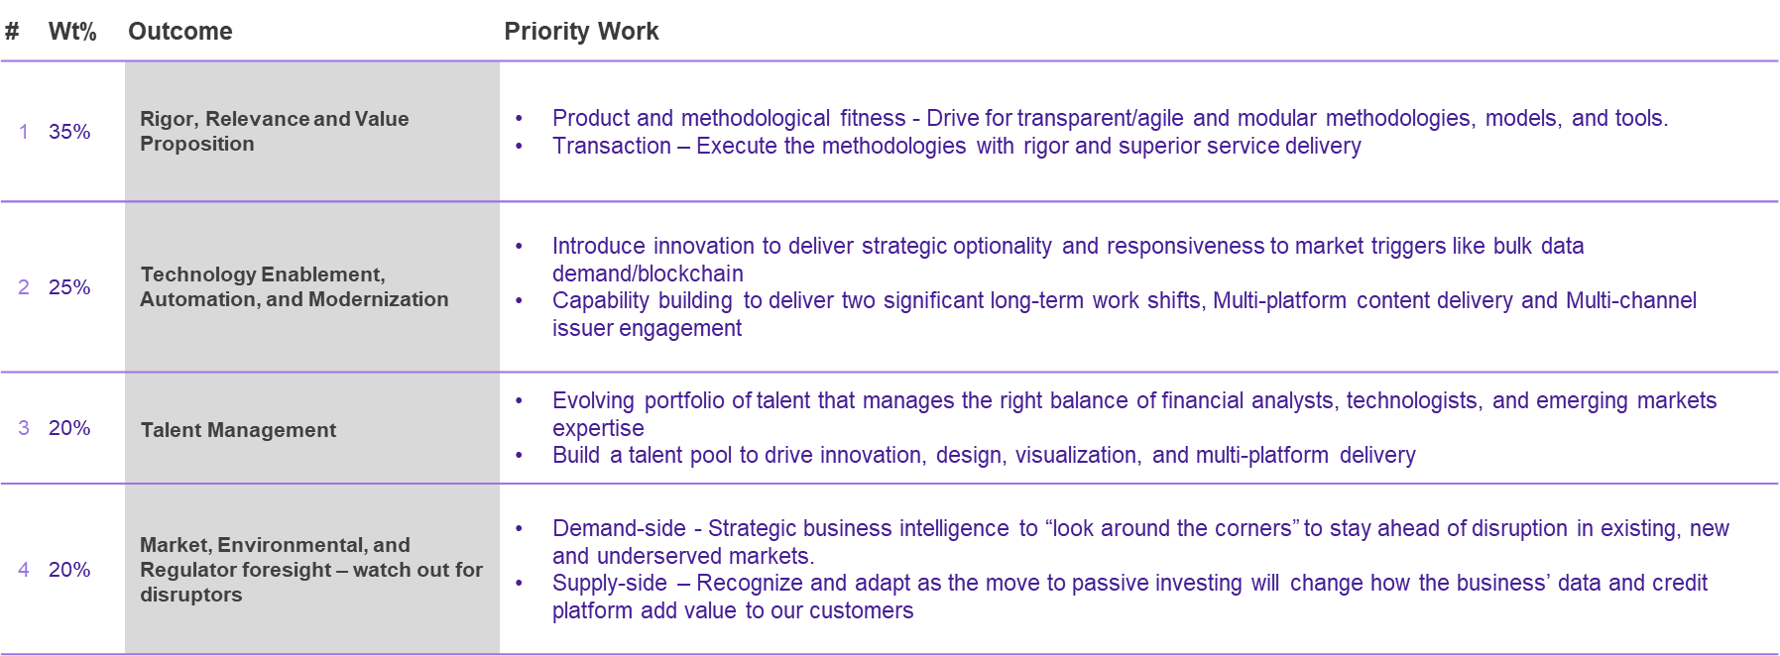
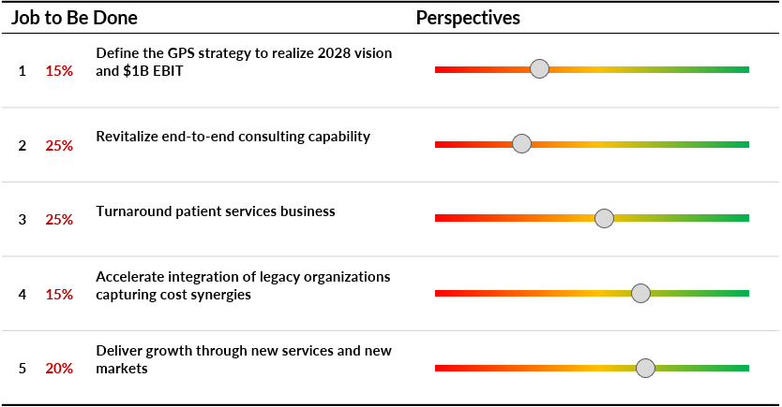
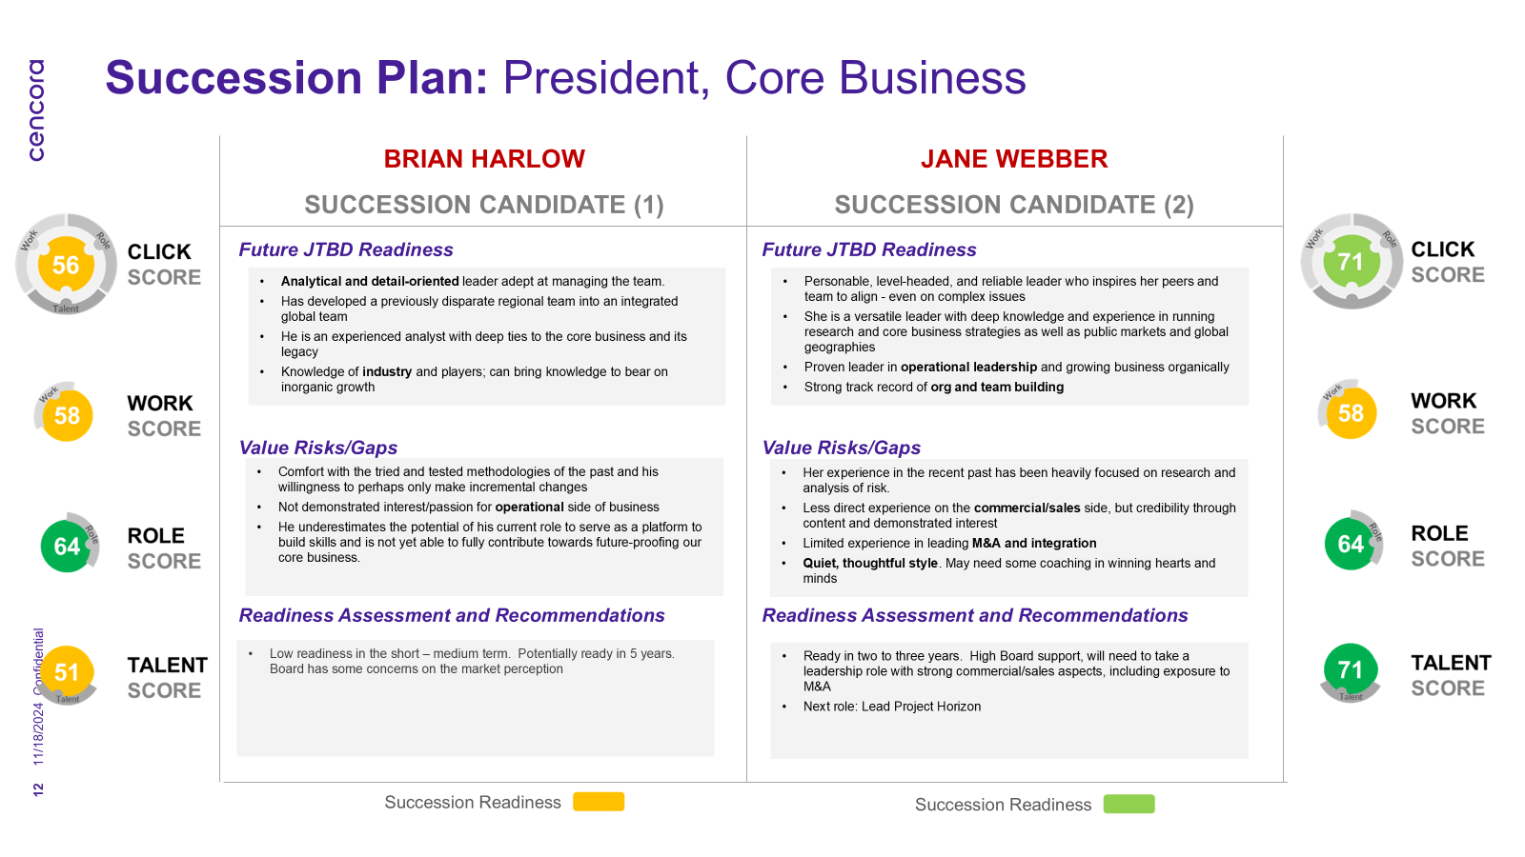
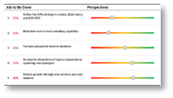
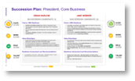
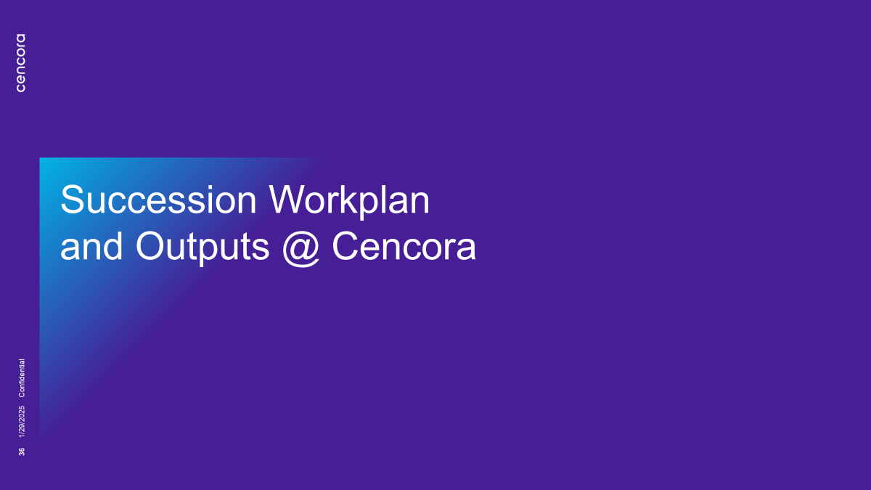
Succession Planning → Succession Readiness
CONFIDENTIAL – NOT TO BE SHARED
/LIST Critical Roles for Succession
/CLICK Succession Readiness
ENABLING Succession Readiness
/CLICKING Succession Readiness
Anchored in
Jobs to be Done
Externally Validated Assessment
Succession Mobilization Plans
Continuous Succession Readiness
Points of Departure

Slide 40
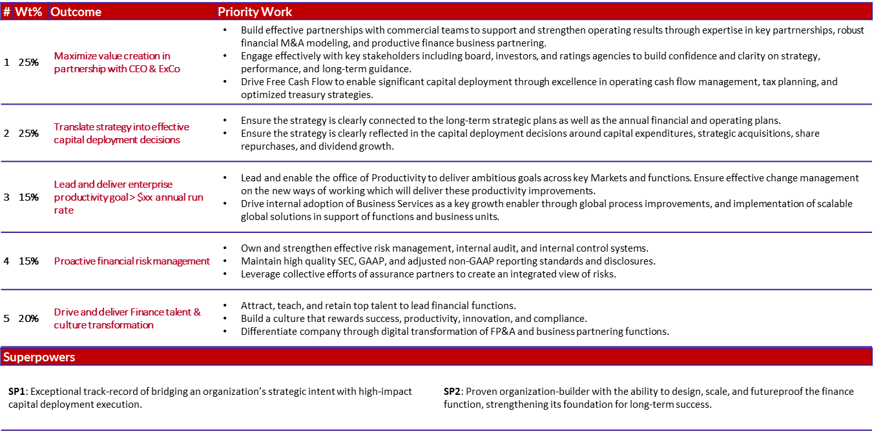
Create ExCo Role Profiles | Define Future Jobs To Be Done
CONFIDENTIAL – NOT TO BE SHARED
EVP Chief Financial Officer
Co-author Future Jobs To Be Done (JTBD) for each ExCo leader considering strategy and long-term strategic plan
Facilitate ExCo peer feedback loop to enhance JTBDs & build alignment
Consider future pivots that may impact JTBD for each role

Slide 41



Identify & Assess Succession Candidates Future JTBDs
CONFIDENTIAL – NOT TO BE SHARED
Initial Assessment by ExCo
Validated Assessment
Candidate
EVP Chief Financial Officer
Readiness
Structured interview by external partner
1
25%
Maximize Value Creation in partnership with CEO & ELT
2
25%
Translate strategy into effective capital deployment decisions
3
15%
Lead and deliver enterprise productivity goal >$xxB annually
Hogan Personality Inventory & Active Learning / Active Leading assessment
4
15%
Proactive Financial Risk Management
5
20%
Drive Finance Talent & Culture Transformation
SP1
Exceptional track-record of bridging an organization’s strategic intent with high-impact capital deployment execution.
Prior performance feedback
SP2
Proven organization builder with the ability to design, scale, and futureproof the finance function
Ready Now
Ready in 1-2 Years
Ready in 3-5 Years

Slide 42
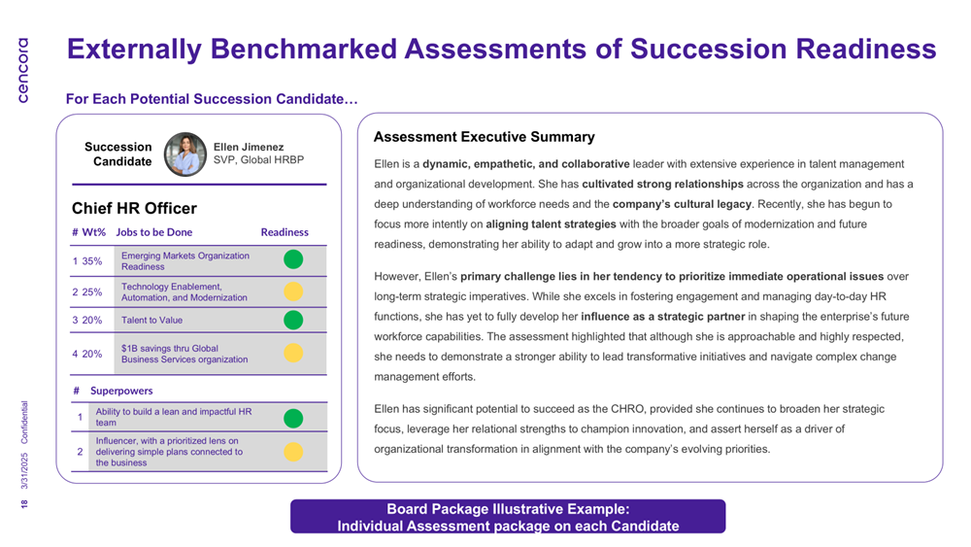
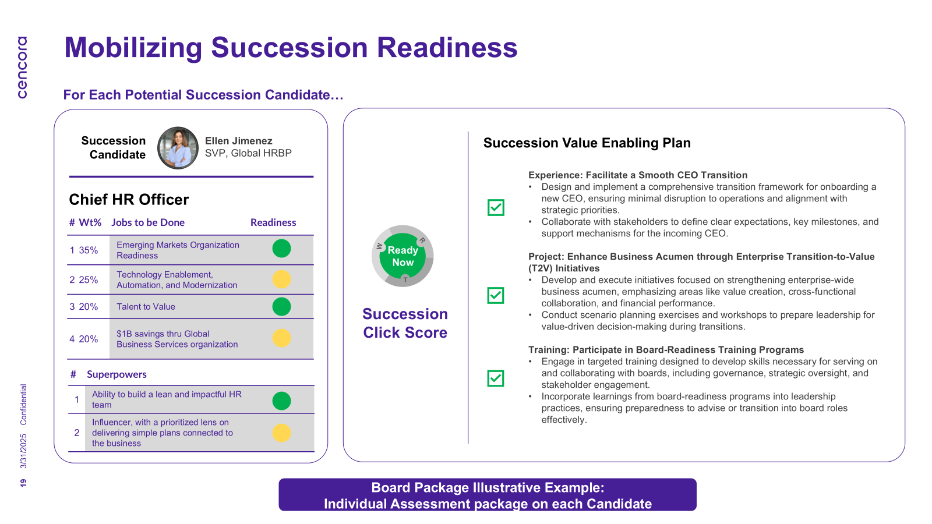
Activate Meaningful Development Plans and Manage Talent Risks
CONFIDENTIAL – NOT TO BE SHARED
Detailed assessment of candidate readiness
Development plans for candidates anchored in Jobs to be Done readiness
Disciplined pull through of the process with quarterly ELT development plan

Slide 43





Mobilization Plan to Cultivate Succession Pipeline
CONFIDENTIAL – NOT TO BE SHARED
ExCo ownership of development
New roles to accelerate development
Talent risk mitigation
Cultivate next generation
Validating succession readiness
Co-creating meaningful development and mentorship
Strategically opening and creating new roles as a platform for development
New Enterprise Forum to accelerate development of next gen leaders
Actively managing retention risk on critical roles and talent
Proactively building external succession pipeline
Elevating focus on VP and below talent pipeline
Activating culture of continuous development and intentional talent rotation

Slide 44
July 2025

